Slide 1
The Structure of a Compiler
Lexical Analysis
Parsing
Semantic Analysis
Optimization
Code Generation
The first 3, at least, can be understood by analogy to how humans comprehend English.

Slide 2
Lexical Analysis
First step: recognize words.
  Smallest unit above letters
This is a sentence.
Note the
  Capital “T” (start of sentence symbol)
  Blank “ “ (word separator)
  Period “.” (end of sentence symbol)

Slide 3
More Lexical Analysis
Lexical analysis is not trivial. Consider:
ist his ase nte nce
Plus, programming languages are typically more cryptic than English:
  *p->f ++ = -.12345e-5

Slide 4
And More Lexical Analysis
Lexical analyzer divides program text into “words” or “tokens”
if x == y then z = 1; else z = 2;
Units:
if, x, ==, y, then, z, =, 1, ;, else, z, =, 2, ;

Slide 5
Parsing
Once words are understood, the next step is to understand sentence structure
Parsing = Diagramming Sentences
  The diagram is a tree

Slide 6
Diagramming a Sentence
This
line
is
a
longer
sentence
article
noun
verb
article
adjective
noun
subject
object
sentence

Slide 7
Parsing Programs
Parsing program expressions is the same
Consider:
If x == y then z = 1; else z = 2;
Diagrammed:
x
==
y
z
1
z
2
relation
assign
assign
predicate
then-stmt
else-stmt
if-then-else

Slide 8
Semantic Analysis
Once sentence structure is understood, we can try to understand “meaning”
  But meaning is too hard for compilers
Compilers perform limited analysis to catch inconsistencies
Some do more analysis to improve the performance of the program

Slide 9
Semantic Analysis in English
Example:
Jack said Jerry left his assignment at home.
What does “his” refer to? Jack or Jerry?
Even worse:
Jack said Jack left his assignment at home?
How many Jacks are there?
Which one left the assignment?

Slide 10
Semantic Analysis in Programming
Programming languages define strict rules to avoid such ambiguities
This C++ code prints “4”; the inner definition is used
{
int Jack = 3;
{
int Jack = 4;
cout << Jack;
}
}

Slide 11
More Semantic Analysis
Compilers perform many semantic checks besides variable bindings
Example:
Jack left her homework at home.
A “type mismatch” between her and Jack; we know they are different people
  Presumably Jack is male

Slide 12
Examples of Semantic Checks
Variables defined before used
Variables defined once
Type compatibility
Correct arguments to functions
Constants are not modified
Inheritance hierarchy has no cycles

Slide 13
Optimization
No strong counterpart in English
Automatically modify programs so that they
  Run faster
  Use less memory
  In general, conserve some resource

Slide 14
Optimization Example
X = Y * 0 is the same as X = 0
NO!
Valid for integers, but not for floating point numbers

Slide 15
Examples of common optimizations
Dead code elimination
Evaluating repeated expressions only once
Replace expressions by simpler equivalent expressions
Evaluate expressions at compile time
Move constant expressions out of loops

Slide 16
Code Generation
Produces assembly code (usually)
A translation into another language
  Analogous to human translation

Slide 17
Issues
Compiling is almost this simple, but there are many pitfalls.
Example: How are erroneous programs handled?
Language design has big impact on compiler
  Determines what is easy and hard to compile
  Course theme: many trade-offs in language design

Slide 18
Compilers and Optimization
What makes a compiler good?
What makes a compiler different?

Slide 19
What’s in an optimizing compiler?
Compilation Stages
High-level
language
(C, C++, Java)
Front End
Optimizer
Code
Generator
Low-level
language

Slide 20
What are compiler optimizations?
Optimization: the transformation of a program P into a program P’, that has the same input/output behavior, but is somehow “better”.
“better” means:
  faster
  or smaller
  or uses less power
  or whatever you care about
P’ is not optimal, may even be worse than P

Slide 21
An optimizations must:
Preserve correctness
  the speed of an incorrect program is irrelevant
On average improve performance
  P’ is not optimal, but it should usually be better
Be “worth the effort”
  1 person-year of work, 2x increase in compilation time, a 0.1% improvement in speed?
  Find the bottlenecks
  90/10 rule: 90% of the gain for 10% of the work

Slide 22
Compiler Phases (Passes)
High-level
language
C, C++, Java
Compiler
Low-level
language
mc68000
tokens
IR
IR
Lexical
Analyzer
Parser
IR Code
Generator
Optimizer
m/c Code
Generator
IR: Intermediate Representation

Slide 23
Lexers & Parsers
The lexer identifies tokens in a program
The parser identifies grammatical phrases, or constructs in the program
There are freely available lexer and parser generators…
The parser usually constructs some intermediate form of the program as output

Slide 24
Intermediate Representation (IR)
The representation or language on which the compiler performs it’s optimizations
There are as many IRs as compiler suites
Some IRs are better for some optimizations
  different information is maintained
  easier to find certain types of information

Slide 25
Why Use an IR?
C
MIPS
C++
Sun SPARC
Java
IR
IA32 / Pentium
Fortran
IA64 / Itanium
Voss++
PowerPC
Good Software Engineering
  Portability
  Reuse

Slide 26
Compiling a C program
A Simple Compilation Example

Slide 27
Writing C Programs
A programmer uses a text editor to create or modify files containing C code.
Code is also known as source code.
A file containing source code is called a source file.
After a C source file has been created, the programmer must invoke the C compiler before the program can be executed (run).

Slide 28
Invoking the gcc Compiler
At the prompt, type
gcc -ansi -Wall pgm.c
where pgm.c is the C program source file.
-ansi is a compiler option that tells the compiler to adhere to the ANSI C standard.
-Wall is an option to turn on all compiler warnings (best for new programmers).

Slide 29
The Result : a.out
If there are no errors in pgm.c, this command produces an executable file, which is one that can be executed (run).
The gcc compiler names the executable file a.out
To execute the program, at the prompt, type
  a.out
Although we call this process “compiling a program,” what actually happens is more complicated.

Slide 30
Stages of Compilation
Stage 1: Preprocessing
  Performed by a program called the preprocessor
  Modifies the source code (in RAM) according to preprocessor directives (preprocessor commands) embedded in the source code
  Strips comments and whitespace from the code
  The source code as stored on disk is not modified.

Slide 31
Stages of Compilation (con’t)
Stage 2: Compilation
  Performed by a program called the compiler
  Translates the preprocessor-modified source code into object code (machine code)
  Checks for syntax errors and warnings
  Saves the object code to a disk file.
    If any compiler errors are received, no object code file will be generated.
    An object code file will be generated if only warnings, not errors, are received.

Slide 32
Stages of Compilation (con’t)
The Compiler consists of the following sub-systems:
  Parser - checks for errors
  Code Generator - makes the object code
  Optimizer - may change the code to be more efficient

Slide 33
Stages of Compilation (con’t)
Stage 3: Linking
  Combines the program object code with other object code to produce the executable file.
  The other object code can come from the Run-Time Library (a collection of object code with an index so that the linker can find the appropriate code), other libraries, or object files that you have created.
  Saves the executable code to a disk file. On a Linux/Unix system, that file is called a.out.
    If any linker errors are received, no executable file will be generated.

Slide 34
Program Development Using gcc
Editor
Source File pgm.c
Preprocessor
Modified Source Code in RAM
Compiler
Program Object Code File pgm.o
Other Object Code Files (if any)
Linker
Executable File a.out

Slide 35
Concepts of Programming Languages
The Programming Language Family Tree

Slide 36
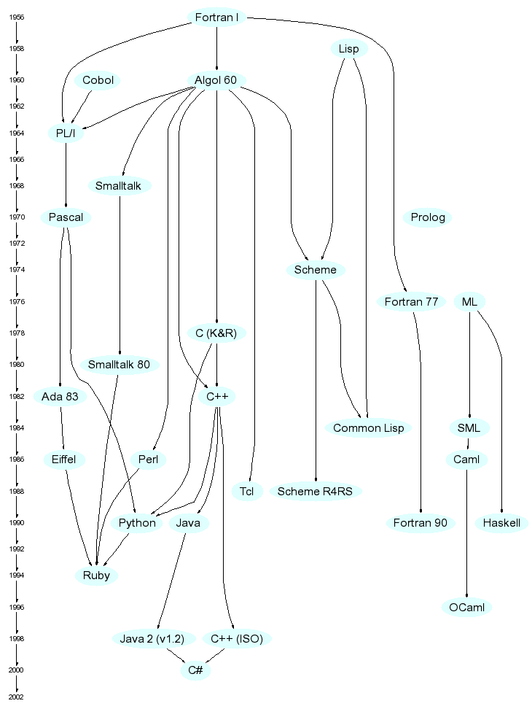
A Family Tree
http://merd.net/pixel/language-study/diagram.html

Slide 37
Plankalkul
Developed by Konrad Zuse (1945)
Never implemented
Advanced data structures (floating point, arrays, records)
Odd notation:
  To code A[7] = 5 * B[6]
    | 5 * B => A
    V | 6 7 (subscripts)
    S | 1.n 1.n (data types)

Slide 38
Pseudocodes
Machine code had many negatives:
  Poor readability, writability, modifiability
  Low-level machine operations had deficiencies, including no indexing or floating point
Example: Short Code
  Developed by Mauchly in 1949 for the BINAC
  Expressions coded from left to right
  Operations included:
    1n => (n+2)nd power (e.g., 12 represented the 4th power)
    2n => (n+2)nd root
    07 => addition

Slide 39
FORTRAN I (1957)
Designed for IBM 704, which had
  Index registers
  Floating point hardware
Development environment
  Computers small and unreliable
  Applications were scientific
  There was no programming methodology or tools
  Machine efficiency was of primary importance

Slide 40
FORTRAN I
Impact of development environment
  Needed good array handling and counting loops
  No need for
    Dynamic storage
    String handling
    Decimal arithmetic
    Powerful input/output operations

Slide 41
FORTRAN I
First implemented version of FORTRAN
  Names could have up to 6 characters
  Posttest counting loop (DO statement)
  Formatted input/output
  User-defined subprograms
  3-way selection statement (arithmetic IF)
  No data typing statements
  Released in 1957 after 18 worker/years effort
  Programs larger than 400 lines rarely compiled correctly (704 was unreliable)
  Code was fast;
  FORTRAN I quickly became widely used

Slide 42
FORTRAN IV (1960-62)
Added features
  Explicit type declarations
  Logical IF statement
  Subprogram names could be parameters

Slide 43
FORTRAN 77 (1978)
Character string handling
Logical loop control statement
IF-THEN-ELSE statement

Slide 44
FORTRAN 90 (1990)
Modules
Dynamic arrays
Pointers
Recursion
CASE statement
Parameter type checking

Slide 45
LISP (1959)
LISt Processing language
Designed by John McCarthy at MIT
Designed to meet AI research needs
  Process data in lists, not arrays
  Symbolic computation, rather than numeric
Two data types: atoms and lists
Syntax based on lambda calculus
Pioneered functional programming
  No need for variables or assignment
  Control via recursion and conditional expressions
COMMON LISP and Scheme are dialects

Slide 46
ALGOL 58 (1958)
Development Environment
  FORTRAN just developed for IBM 704
  Many other machine-specific languages were being developed
  There were no portable languages
  There was no universal language for communicating algorithms

Slide 47
ALGOL 58
Goals for the language
  Close to mathematical notation
  Good for describing algorithms
  Must be translatable to machine code
Notes:
  Not meant to be implemented, but variations were (MAD, JOVIAL)
  IBM was initially enthusiastic, but dropped support by mid 1959

Slide 48
ALGOL 58 Features
Type concept was formalized
Names could have any length
Arrays could have any number of subscripts
Parameters had mode (in/out)
Subscripts were placed in brackets
Compound statements (begin..end)
Semicolon used as statement separator
Assignment operator was :=
if statement had an else-if clause

Slide 49
ALGOL 60 (1960)
New features included
  Block structure (local scope)
  Two parameter passing methods
  Subprogram recursion
  Stack-dynamic arrays
Still lacked
  Input/output
  String handling

Slide 50
ALGOL 60
Successes
  Standard for publishing algorithms for more than 20 years
  Basis for all subsequent imperative languages
  First machine-independent language
  First language whose syntax was formally defined (BNF was used)

Slide 51
ALGOL 60
Failures
  Never widely used, especially in U.S.
  No I/o
  Too flexible, making it hard to implement
  FORTRAN was firmly entrenched
  Formal syntax description (BNF considered strange at the time)
  Lack of support by IBM

Slide 52
COBOL (1960)
Based on UNIVAC FLOW-MATIC
  Names up to 12 characters, with embedded hyphens
  English names for arithmetic operators
  Data and code were completely separate
  Verbs were the first word in every statement
Design Goals
  Must look like simple English
  Ease of use more important than powerful features
  Broaden base of computer users
  Must not be biased by current compiler problems

Slide 53
COBOL
Contributions
  First macro facility in HLL
  Hierarchical data structures (records)
  Nested selection statements
  Long names (up to 30 characters)
  Data Division
Notes
  First language required by DoD
  Still the most widely used business application language

Slide 54
BASIC (1964)
Kemeny & Kurtz (Dartmouth)
Design goals
  Easy to learn and use (non-science students)
  Fast turnaround for homework
  Free and private access
  User time more important than computer time
Current dialects
  QuickBASIC, Visual BASIC

Slide 55
PL/I (1965)
Designed by IBM and SHARE for scientific and business computing
Contributions
  First unit-level concurrency
  First exception handling
  Switch-selectable recursion
  Pointer data type
  Array cross sections
Notes:
  Many features were poorly designed
  To large and complex
  Still used for scientific and business applications

Slide 56
Early Dynamic Languages
Characterized by dynamic typing and dynamic storage allocation
  APL (A Programming Language) 1962
    Designed a hardware description language
    Many operators for scalars and arrays
    Programs are difficult to read
  SNOBOL (1964)
    String manipulation language (Bell Labs)
    Powerful pattern matching operators

Slide 57
ALGOL 68 (1968)
Not really a superset of ALGOL 60
Design based on orthogonality
Contributions
  User-defined data structures
  Reference types
  Dynamic (flex) arrays
Notes
  Even less usage than ALGOL 60
  Strong influence on Pascal, C, and Ada

Slide 58
Pascal (1971)
Designed by Wirth (quit ALGOL 68 committee)
Intended to be used for teaching structured programming
Small, simple, introduced nothing new
Widely used for teaching programming in college, but is being supplanted by C++ and Java

Slide 59
C (1972)
Designed for systems programming (Bell Labs, Dennis Richie)
Evolved from B and ALGOL 68
Powerful set of operators
Poor type checking
Initially spread via UNIX

Slide 60
Other Descendants of ALGOL
Modula-2 (Wirth, mid-1970s)
  Pascal plus modules and low-level features for systems programming
Modula-3 (late 1980s)
  Modula-2 plus classes, exception handling, garbage collection, and concurrency
Oberon
  Adds OOP support to Modula-2
Delphi (Borland)
  Pascal plus OOP features
  More elegant, safer than C++

Slide 61
Prolog (1972)
Developed by Comerauer, Roussel, Kowalski
Based on formal logic
Non-procedural
Can be described as being an intelligent database system that uses an inferencing process to infer the truth of given queries

Slide 62
Ada (1983)
Huge design effort
Contributions
  Packages support data abstraction
  Elaborate exception handling
  Generic program units
  Concurrency through the tasking model
Ada 95
  OOP support through type derivation
  New concurrency features for shared data

Slide 63
Smalltalk (1972-1980)
Developed at Xerox PARC (Alan Kay)
First full implementation of an object-oriented language
  Data abstraction
  Inheritance
  Dynamic type binding
Pioneered the graphical user interface

Slide 64
C++ (1985)
Bell Labs (Stroustrup)
Evolved from C and SIMULA 67 (class)
Facilities for OOP were added to C
Also has exception handling
Supports both procedural and OO programming
Large and complex
Eiffel (1992), a related language that supports OOP
  Not directly derived from any other language
  Smaller and simpler than C++

Slide 65
Java (1995)
Developed at Sun in early 1990s
Based on C++
  Significantly simplified
  Supports only OOP
  Has references, but not pointers
  Includes support for applets and a form of concurrency (threads)

Slide 66
Scripting Languages
JavaScript (1995)
  Originally LiveScript, developed jointly by Netscape and Sun Microsystems
  Used as an HTML-embedded client-side scripting language, primarily for creating dynamic HTML documents
PHP (1995)
  Developed by Rasmus Lerdorf
  An HTML-embedded server side scripting language
  Provides support for many DBMS

Slide 67
C# (2002)
Based on C++ and Java, with ideas from Delphi and Visual Basic
A language for component-based development in the .NET Framework
Likely to become very popular because of Microsoft’s huge effort to push .NET

Slide 68
A Family Tree
http://merd.net/pixel/language-study/diagram.html

Slide 69
The End
Read Chapters 1 and 2 in the Textbook

